Slide 1
OPTIMIZING RESOURCE ALLOCATION IN MULTI-ACCESS EDGE COMPUTING FOR 5G NETWORKS WITH BLOCKCHAIN-BASED VALIDATION
Team Members:
21i320 Karthik R
21i343 Prithiv Vijai U G
21i344 Pukalvanan L
21i366 Vinu V
Project Guide
Dr. Anitha Kumari K
Associate Professor
Department of Information Technology
PSG College of Technology
Coimbatore.

Slide 2
Introduction
With the rise of 5G networks, the demand for ultra-low latency and high-speed connectivity has grown exponentially. Multi-Access Edge Computing (MEC) has emerged as a transformative solution by bringing data processing closer to users, enabling faster and more efficient performance. MEC supports various 5G applications, including enhanced Mobile Broadband (eMBB), Ultra-Reliable Low-Latency Communication (URLLC), and Massive Machine-type Communication (mMTC), making it a cornerstone for next-generation technologies like IoT, smart cities, and autonomous systems.

Slide 3
Problem Statement
The increasing complexity and demand for high-performance applications in modern 5G networks necessitate efficient and secure resource optimization strategies. Multi-Access Edge Computing (MEC) offers low-latency, high-bandwidth, and reliable services at the network's edge. However, achieving dynamic resource allocation to meet diverse application requirements remains a significant challenge. Current approaches often lack modularity, and robust security, which are essential for applications such as enhanced Mobile Broadband (eMBB), Ultra-Reliable Low-Latency Communication (URLLC), and massive Machine-Type Communication (mMTC). Additionally, ensuring the integrity, confidentiality, and reliability of resource allocation processes underscores the growing importance of innovative solutions, such as blockchain, to effectively address these challenges.

Slide 4
Literature Survey :
S.No | Title and Authors of the paper | Publication Year and Conference | Inferences | Drawbacks
1. | Blockchain-Enabled Federated Learning-Based Resource Allocation and Trading for Network Slicing in 5G by D. Ayepah-Mensah, G. Sun, G. O. Boateng, et al. | 2024, IEEE/ACM Transactions on Networking | Federated learning and blockchain improve resource allocation efficiency and transparency in network slicing. | Limited scalability and higher computational overhead.
2. | DBNS: A Distributed Blockchain-Enabled Network Slicing Framework for 5G Networks by M. A. Togou et al. | 2020, IEEE Communications Magazine | Proposes a secure, distributed network slicing framework for 5G networks. | Complexity in managing distributed ledgers.

Slide 5
Cont’d
3. | SliceBlock: Context-Aware Authentication Handover and Secure Network Slicing Using DAG-Blockchain in Edge-Assisted SDN/NFV-6G Environment by I. H. Abdulqadder and S. Zhou. | 2022, IEEE Internet of Things Journal. | Context-aware blockchain supports secure handovers and efficient slicing in edge-assisted networks. | Results in higher latency during context verification.
4. | Consortium Blockchain Based Spectrum Trading for Network Slicing in 5G RAN: A Multi-Agent Deep Reinforcement Learning Approach by G. O. Boateng, G. Sun, D. A. Mensah, D. M. Doe, R. Ou, and G. Liu. | 2023, IEEE Transactions on Mobile Computing. | The framework uses consortium blockchain for secure, transparent spectrum trading, ensuring trust without central authority. | Integrating blockchain with 5G infrastructure demands careful compatibility and interoperability, complicating deployment.

Slide 6
Cont’d
5. | MEC Support for 5G-V2X Use Cases through Docker Containers by C. Campolo, A. Iera, A. Molinaro, and G. Ruggeri. | 2019, IEEE Wireless Communications and Networking Conference. | Utilizes MEC and Docker containers to improve 5G-V2X application support. | Limited adaptability to dynamic vehicular scenarios.
6. | Blockchain-Based Computing Resource Trading in Autonomous Multi-Access Edge Network Slicing: A Dueling Double Deep Q-Learning Approach by T. Kwantwi, G. Sun, N. A. E. Kuadey, G. T. Maale, and G. Liu. | 2023, IEEE Transactions on Network and Service Management. | Utilizes blockchain for secure, transparent, and decentralized resource trading, preventing data tampering and fraud while offering a verifiable record of resource allocation. | Performance degrades under high network traffic.

Slide 7
Cont’d
7. | Deep Reinforcement Learning for Edge Computing Resource Allocation in Blockchain Network Slicing Broker Framework by Y. Gong, S. Sun, Y. Wei, and M. Song. | 2021, IEEE Vehicular Technology Conference. | Introduces a reinforcement learning framework for resource allocation in blockchain-based slicing. | Requires significant computational power for real-time applications.
8. | IIoT-MEC: A Novel Mobile Edge Computing Framework for 5G-enabled IIoT by X. Hou, Z. Ren, K. Yang, C. Chen, H. Zhang, and Y. Xiao. | 2019, IEEE Wireless Communications and Networking Conference. | Proposes a MEC framework for 5G-enabled Industrial IoT. | Lacks scalability for larger industrial networks.

Slide 8
Drawbacks of existing system:
Inefficient Resource Allocation: Unable to dynamically adjust for varying latency and signal strength, causing wastage.
Limited Automation: Requires manual intervention for resource management, leading to delays and errors.
Security Issues: Lack of security in decentralized resource management, increasing vulnerability to attacks.
Lack of Transparency: No clear tracking of resource allocation, affecting trust and service efficiency.

Slide 9
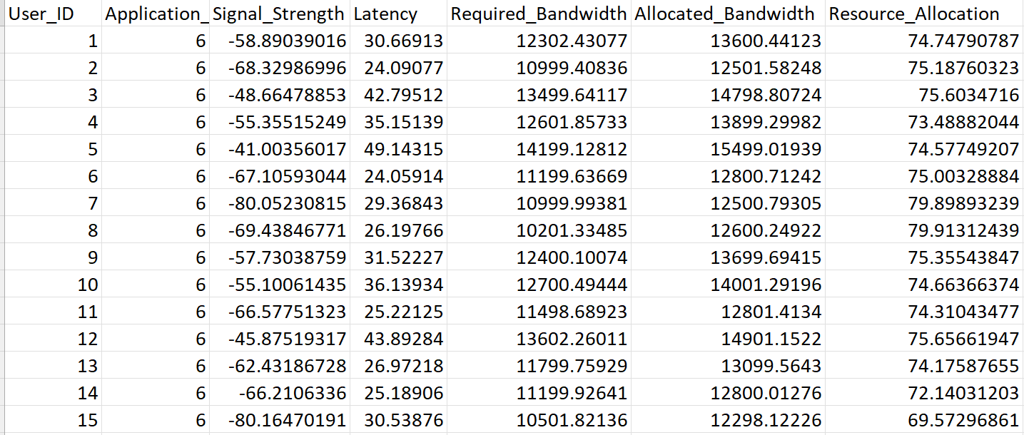
Dataset Used :
5G user allocation dataset :
7 features and 16000 rows
Dataset link - https://www.kaggle.com/datasets/vinu1233/augmented-5g-dataset-for-resource-allocation

Slide 10
Requirements :
Technologies :
Containerization & Blockchain: Docker, Truffle, Ganache, Web3
Python Packages :
Machine Learning: LightGBM, XGBoost, Scikit-learn
Data Processing: Pandas, NumPy, JSON
Visualization: Matplotlib
Web & API Handling: Flask (Request)
System & Utilities: OS, Time
Development Environment :
IDE: Visual Studio Code (VS Code)
Simulation: NS-3

Slide 11
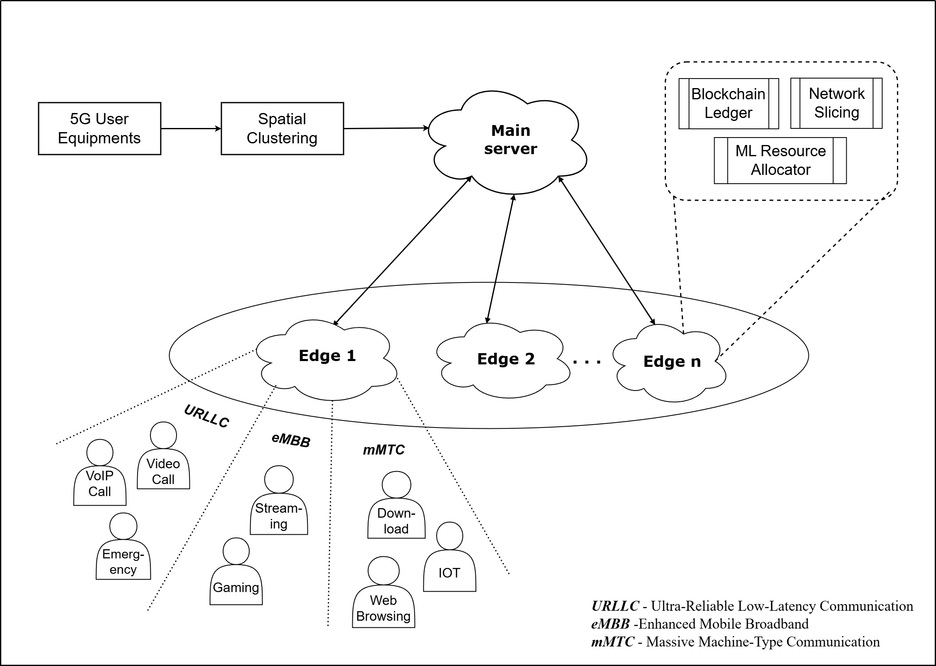
Proposed Methodology – Block Diagram :

Slide 12
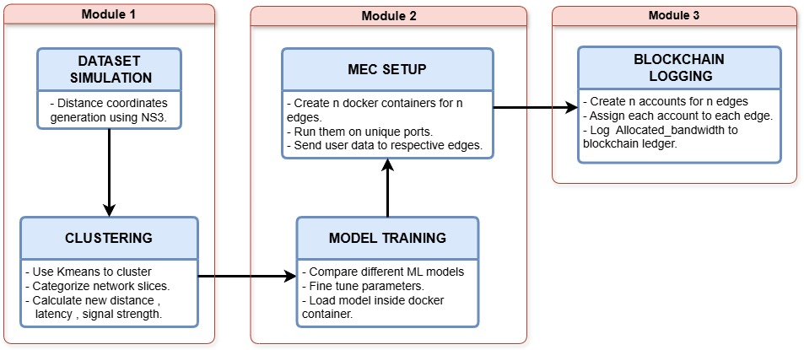
Module split-up:

Slide 13
(I) Dataset Simulation:
Distance simulation using NS3:
The distance for each user is calculated based on Signal Strength and Latency using NS-3's inbuilt propagation models.
The Friis Propagation Loss Model from NS-3 is used to estimate the distance based on the signal strength.
Latency is used to calculate distance by assuming signal propagation at the speed of light.
This process ensures that both signal quality (via strength) and network performance (via latency) are considered to calculate the most accurate distance estimate and then a random angle is introduced to acquire the x,y coordinates for each user.

Slide 14
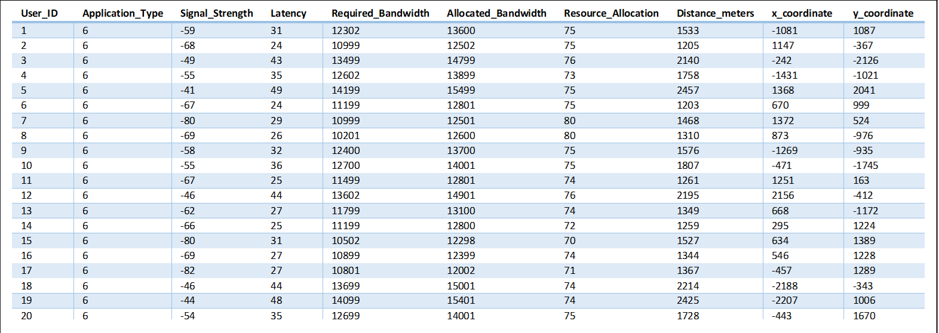
(I) Dataset Simulation :
Simulated dataset :

Slide 15
(I) Clustering:
Step 1 : Categorize the application types to 3 different network slices namely
eMBB - Background_Download, File_Download, Streaming, Video_Streaming
URLLC - Emergency_Service, Online_Gaming, Video_Call, VoIP_Call, Voice_Call
mMTC - IoT_Temperature, Web_Browsing
Step 2 : Perform clustering using k-means algorithm to assign users to edges (k - no of edge nodes )
Step 3 : Calculate the new distance between the user and assigned edge node and update the signal strength and latency accordingly.

Slide 16
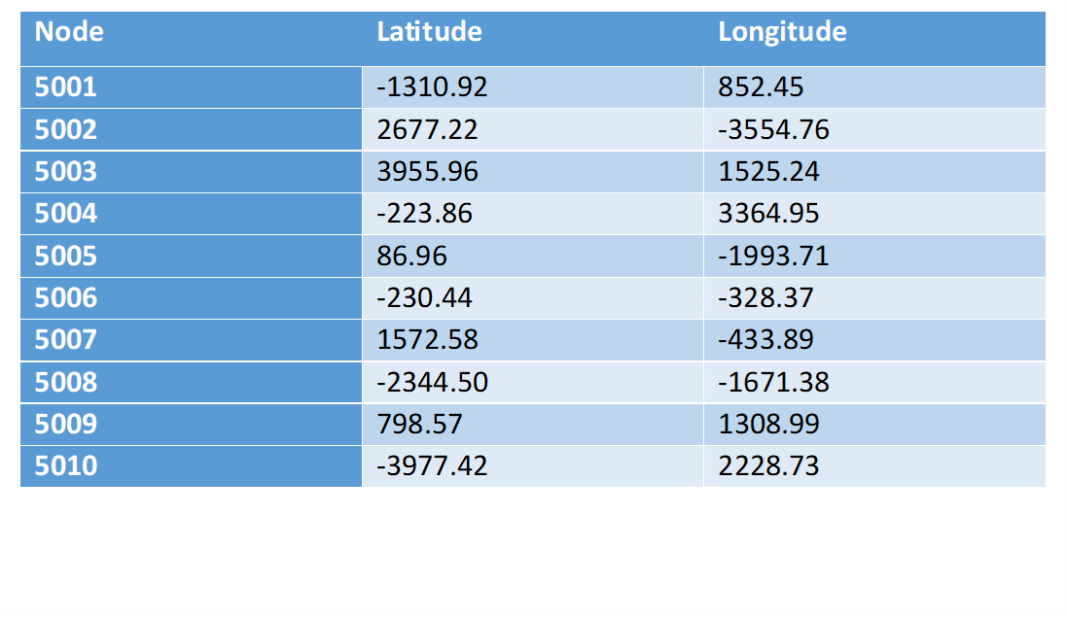
(I) Clustering :
Container positions after Clustering:

Slide 17
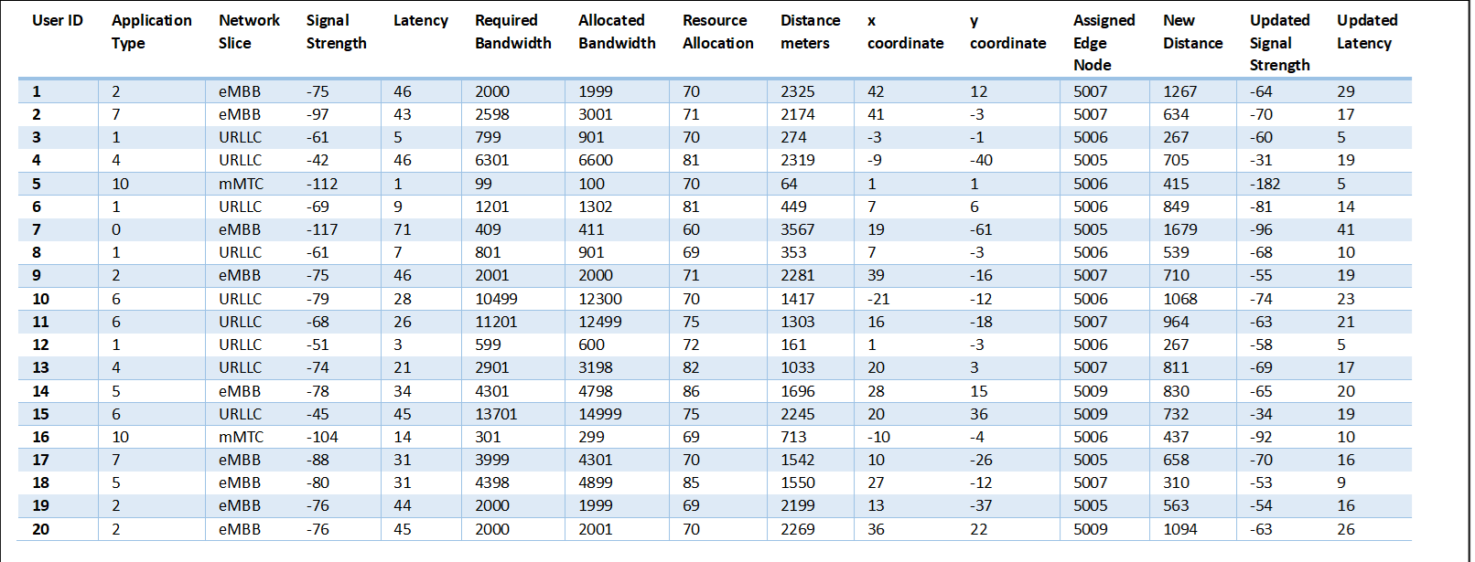
(I) Clustering :
Post Clustered Data:

Slide 18
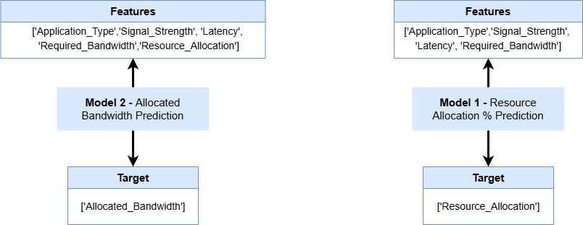
(II) Model Training :
Model 1- Resource Allocation Prediction:
Train-Test split – 70/30
Cross Fold Validation – 5 splits

Slide 19
(II) Model Training :
Model 2 – Allocated Bandwidth Prediction :
Train-Test split – 70/30
Cross Fold Validation – 5 splits

Slide 20
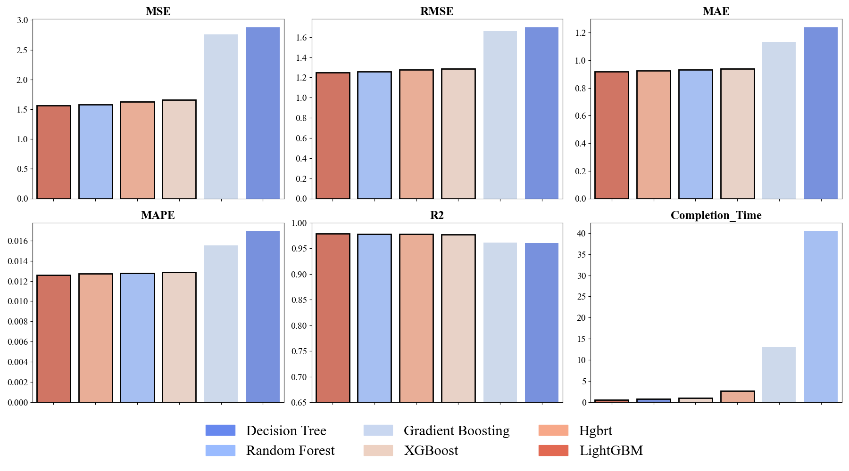
(II) Model Training :
Performance evaluation of ML models for Resource Allocation Prediction (model 1) :
- LightGBM outperforms other models in all metrics

Slide 21
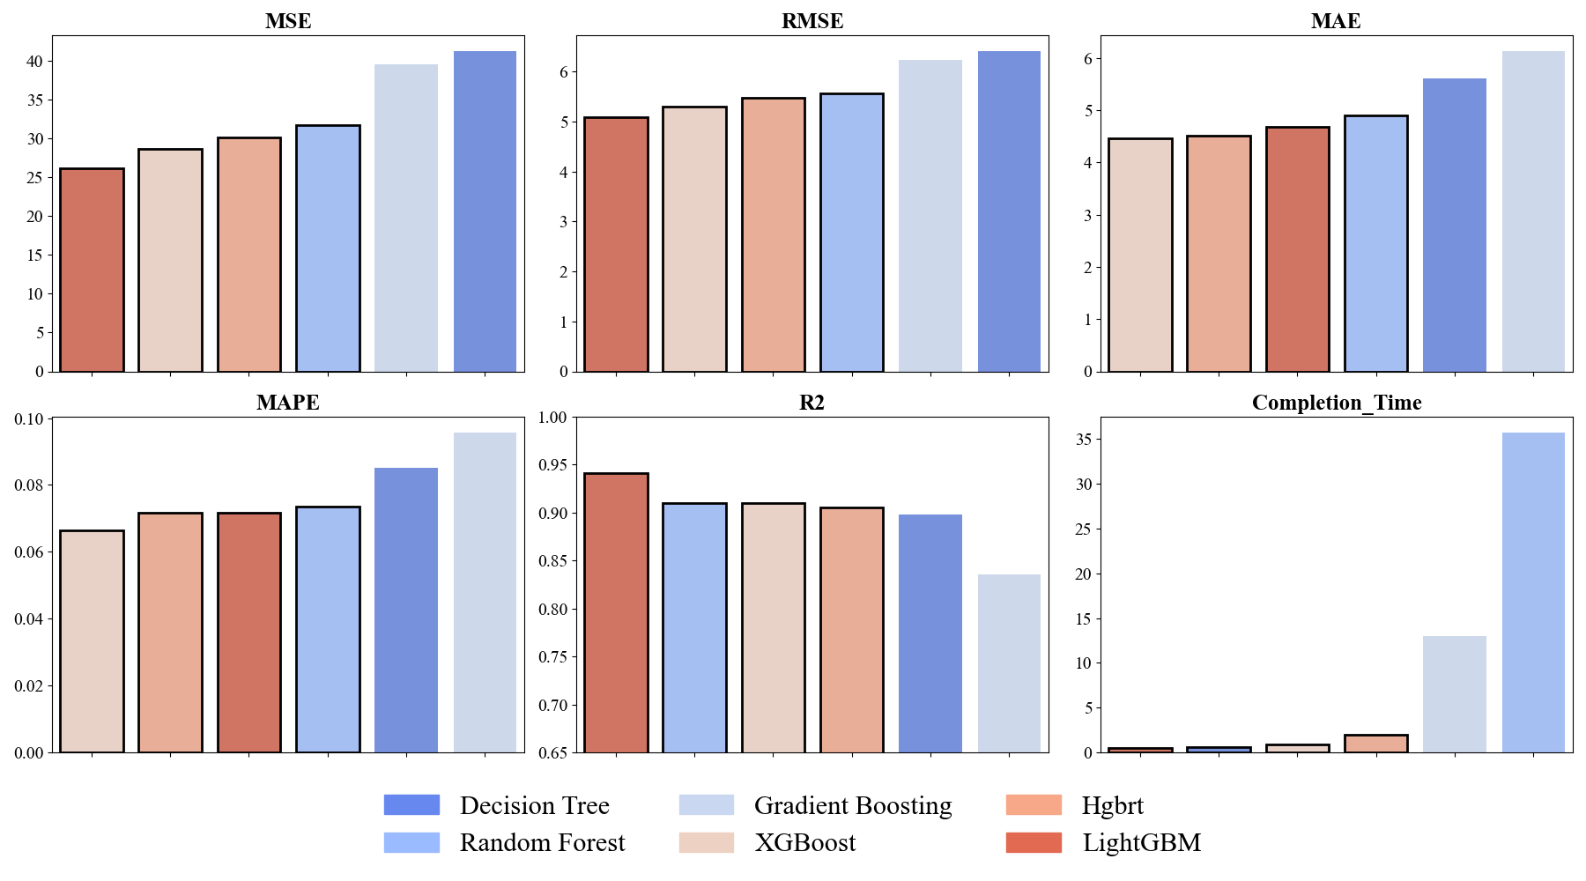
(II) Model Training :
Performance evaluation of ML models for Allocated Bandwidth Prediction (model 2):
- LightGBM tops in mse, rmse, r2 and completion time while XGBoost tops in mae and mape metrics.

Slide 22
(II) Model Training :
LightGBM – Algorithm:

Slide 23
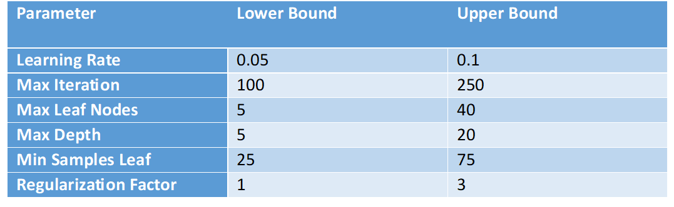
(II) Model Training :
Hyperparameter range used for Optimization :
All these are common for LightGBM ,XGBoost , HGBRT while for random forest the learning rate and regularization factor won’t be applicable.

Slide 24
(II) Model Training :
Bayesian Optimization
(Gaussian Process)
Algorithm:

Slide 25
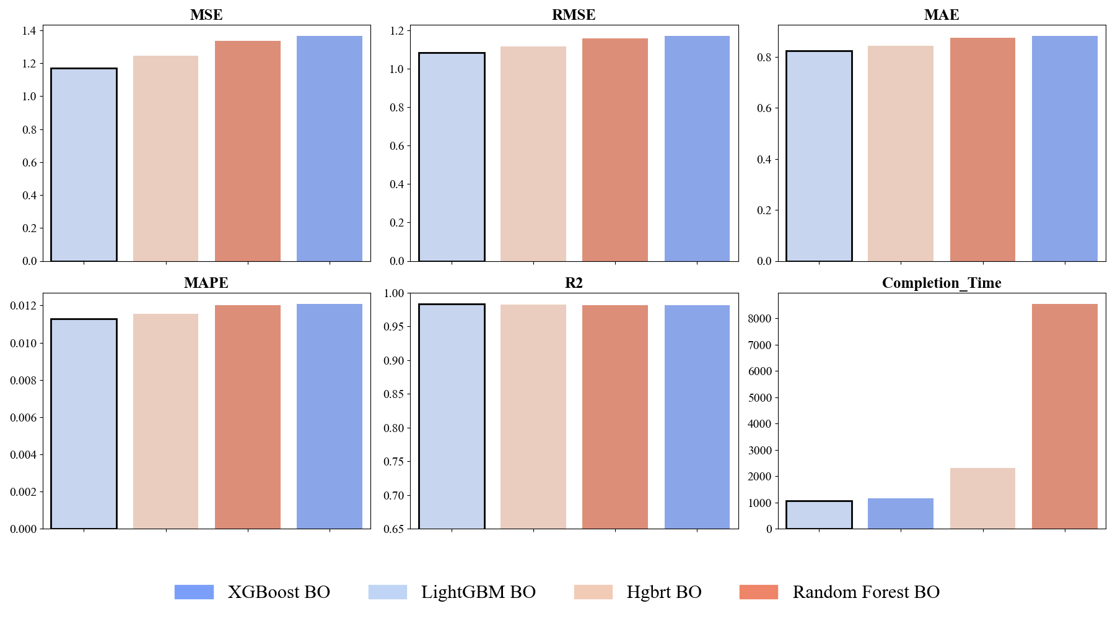
(II) Model Training :
Model 1 - Performance analysis of top four models optimized with Bayesian Optimization (Gaussian Process) :
- LightGBM outperforms other models in all metrics

Slide 26
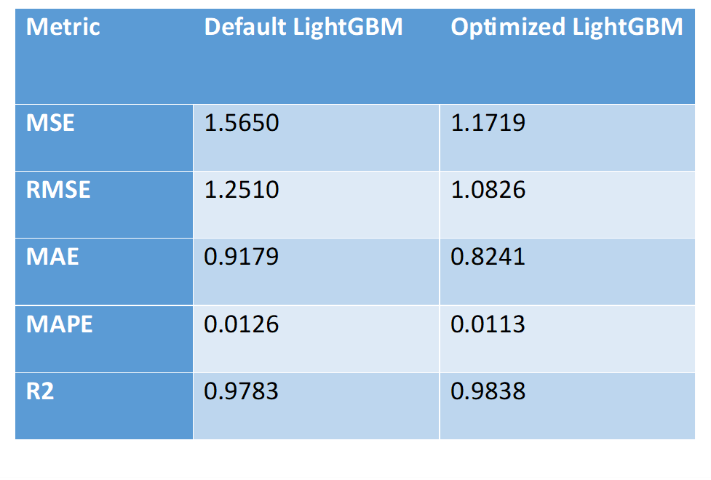
(II) Model Training :
Best Metrics – Resource Allocation (Model 1) :

Slide 27
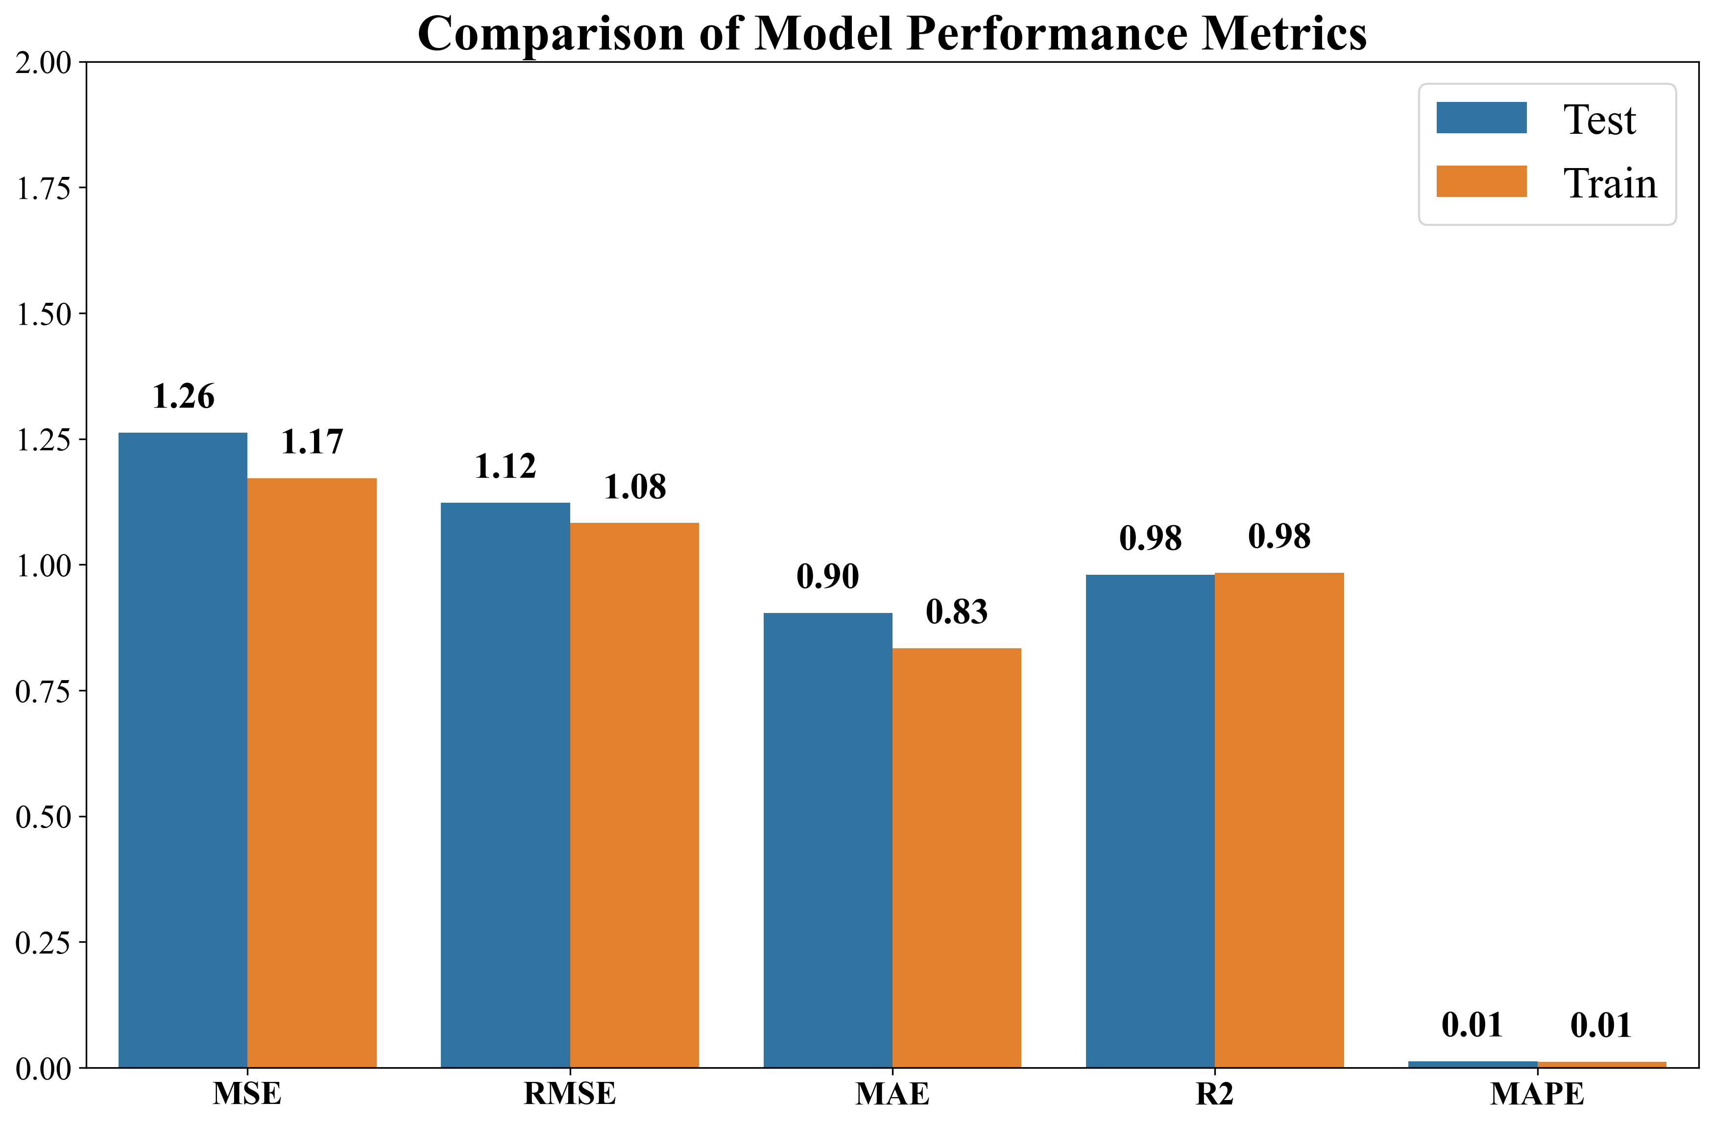
(II) Model Training :
No Significant Overfitting or Underfitting: Given that both the training and testing metrics are close and the R² values are high, it suggests that the model is neither overfitting nor underfitting. It appears to be fitting the data well.

Slide 28
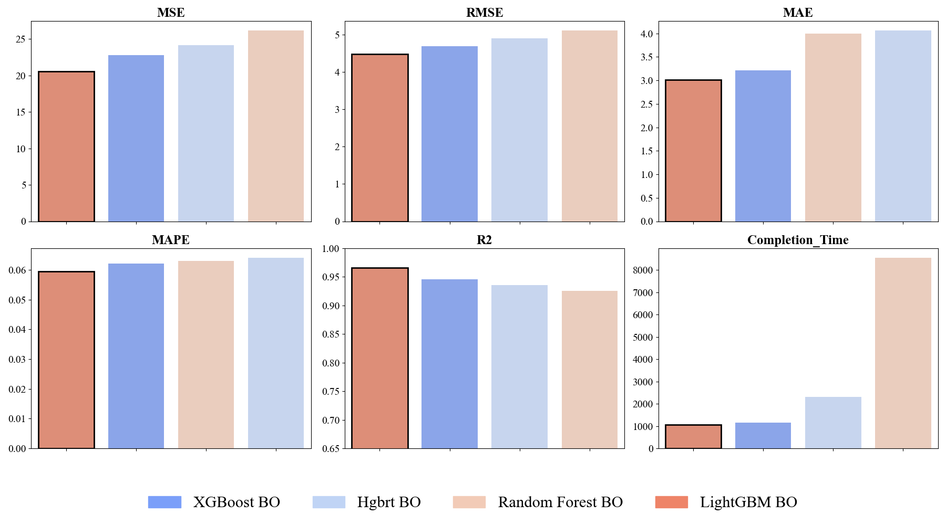
(II) Model Training :
Model 2 - Performance analysis of top four models optimized with Bayesian Optimization (Gaussian Process):
- LightGBM outperforms other models in all metrics

Slide 29
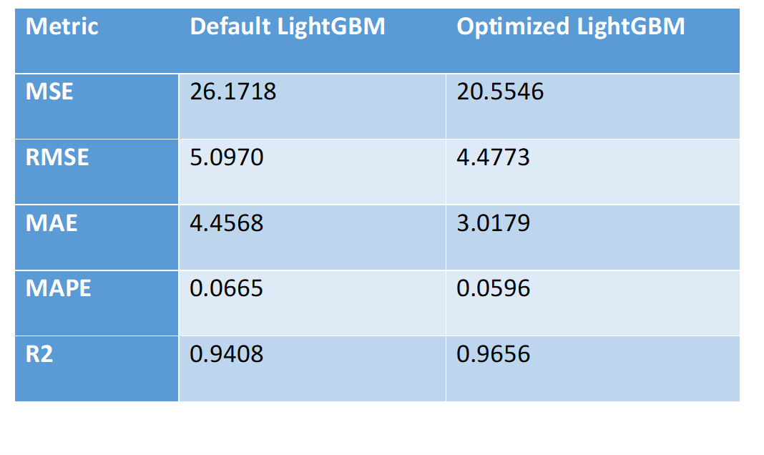
(II) Model Training :
Best Metrics – Allocated Bandwidth (Model 2) :

Slide 30
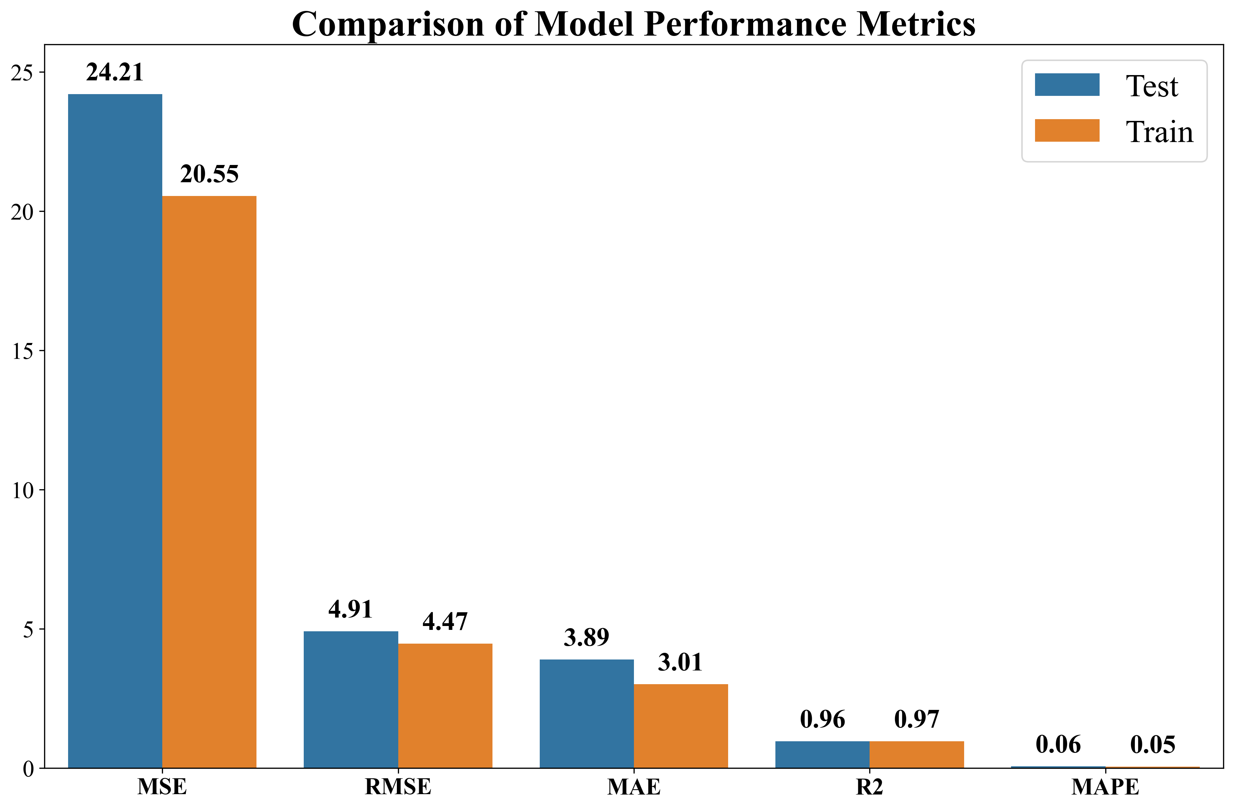
(II) Model Training :
No Significant Overfitting or Underfitting: Given that both the training and testing metrics are close and the R² values are high, it suggests that the model is neither overfitting nor underfitting. It appears to be fitting the data well.

Slide 31
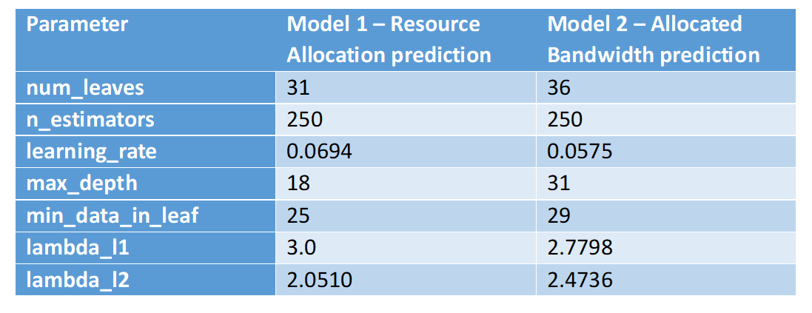
(II) Model Training :
Optimal Hyperparameters Tuned by Bayesian Optimization with Gaussian Process :

Slide 32
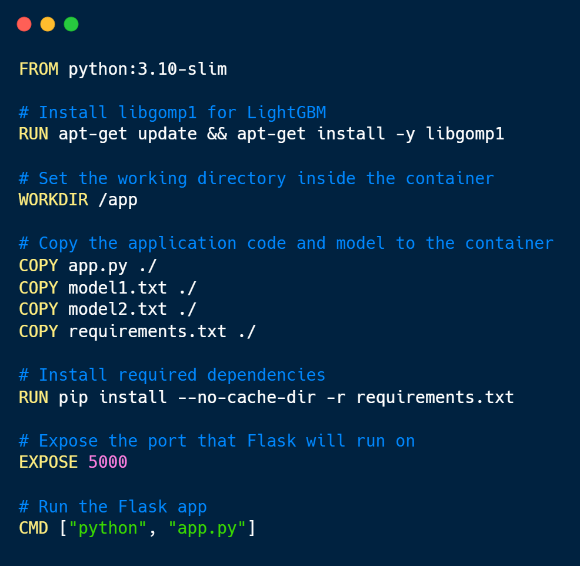
(II) MEC setup :
Step 1 : Create dockerfile with all necessary commands.
Pretrained LightGBM models
Server port
Flask entry point for receiving user data

Slide 33
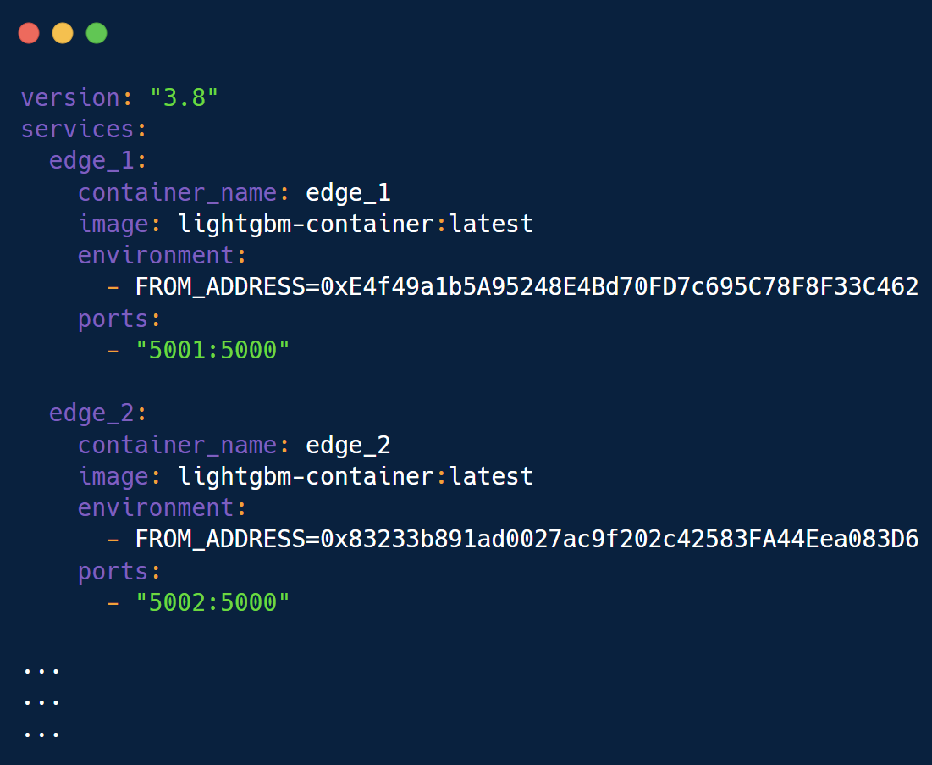
(II) MEC setup :
Step 2 : Specify unique address and port numbers in the docker-compose.yml file.
Unique address for blockchain logging
Unique port number for each edge

Slide 34
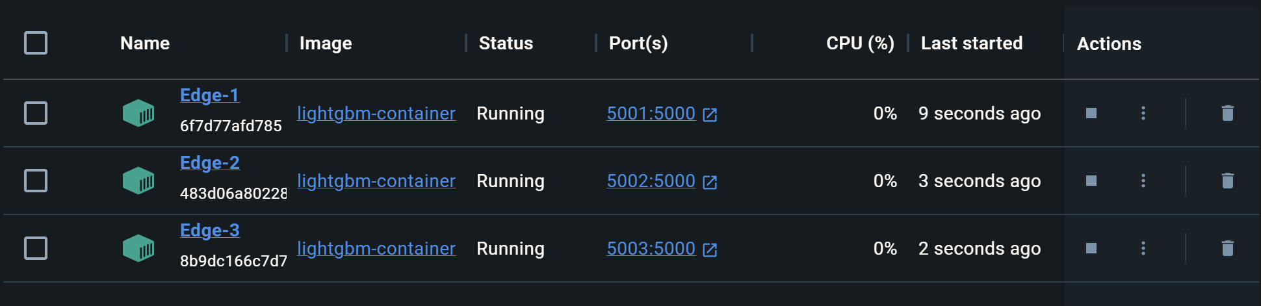
(II) MEC setup :
Step 3 : Keep the edge containers up and running waiting to receive user data from server (central node).

Slide 35
(II) MEC setup :
Step 4: Send user input data to respective edge nodes (container) .
Step 5: Enforce QoS rules on post prediction data.
URLLC - If latency > 10 ms
eMBB - If allocated bandwidth < 10000 Kbps
mMTC - If allocated bandwidth < 100 Kbps
For the above cases boost the allocated bandwidth by 10%.
Step 6: Upload the user_id and final allocated_bandwidth to blockchain.

Slide 36
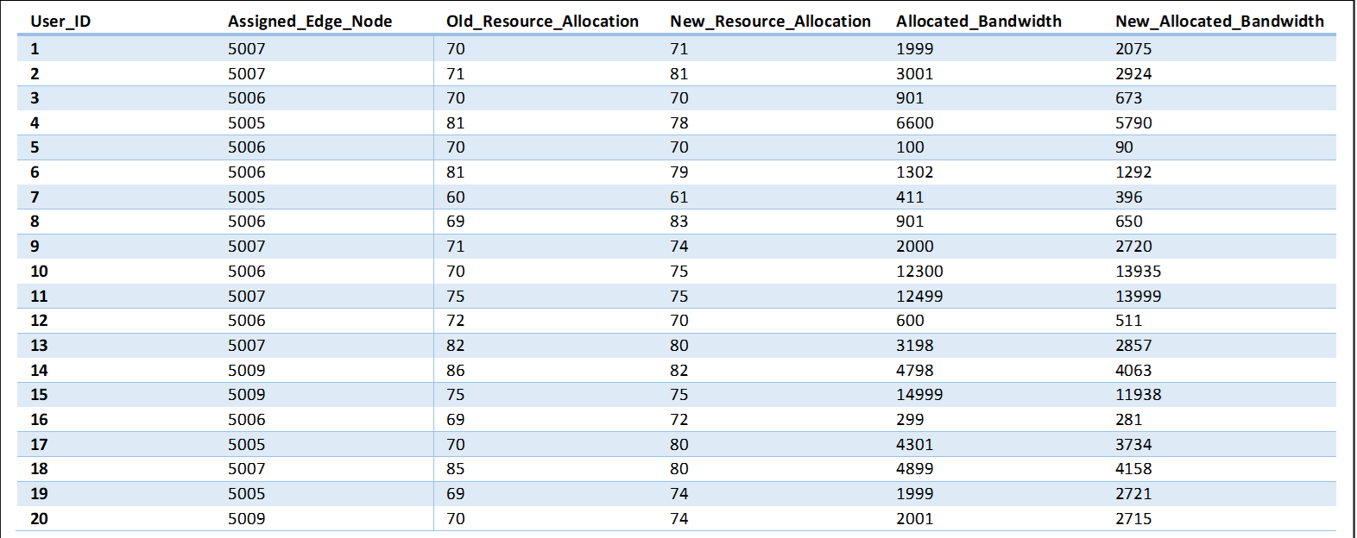
(II) MEC setup :
Post Prediction Data : Received by the central node (server) from the edge nodes (docker containers).

Slide 37
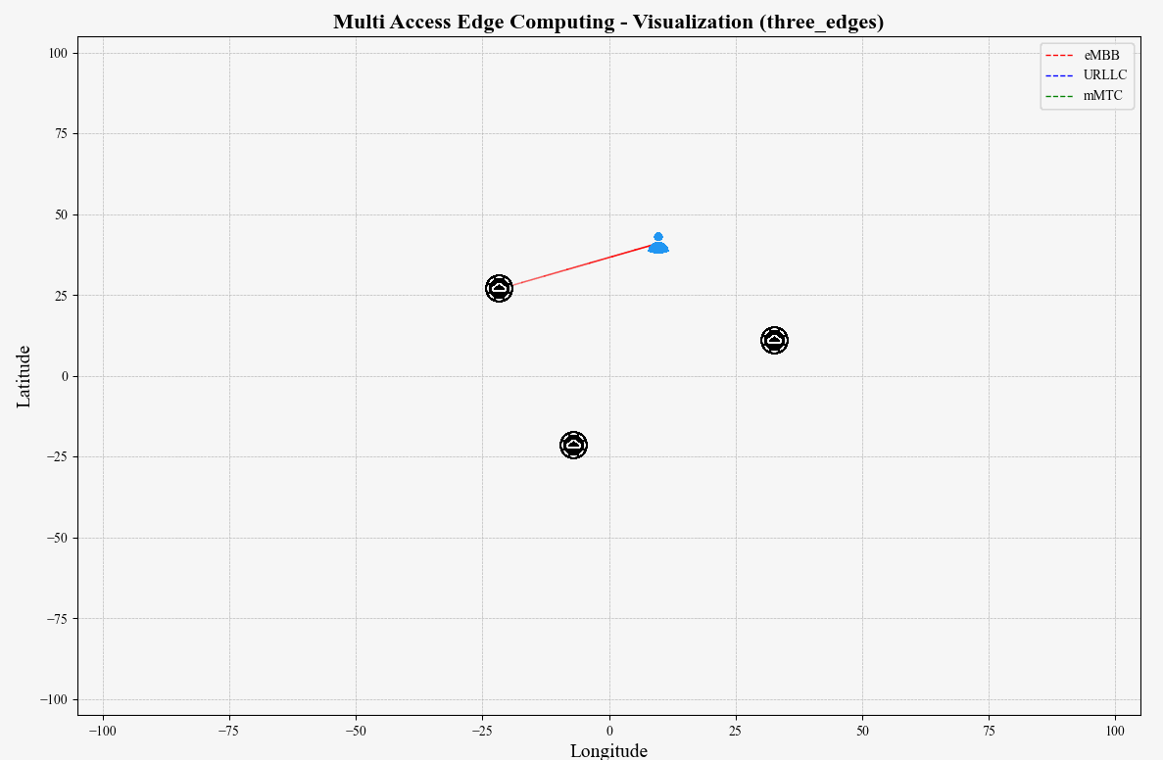
(II) MEC setup :
MEC Visualization :

Slide 38
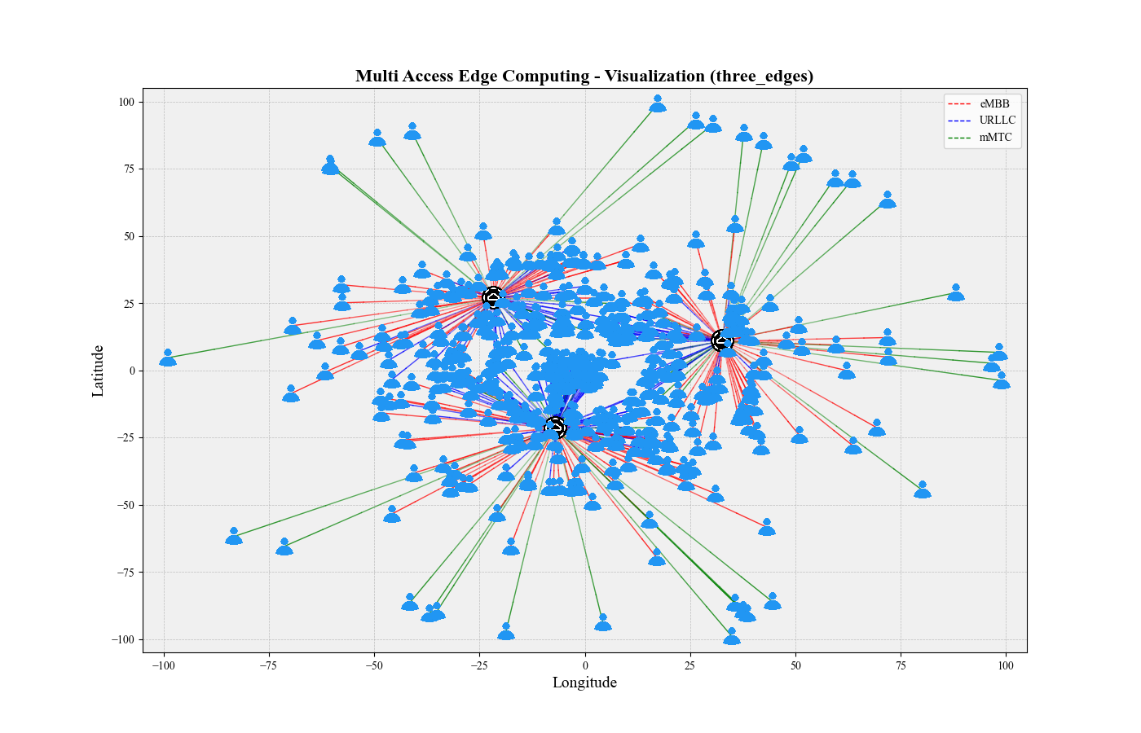
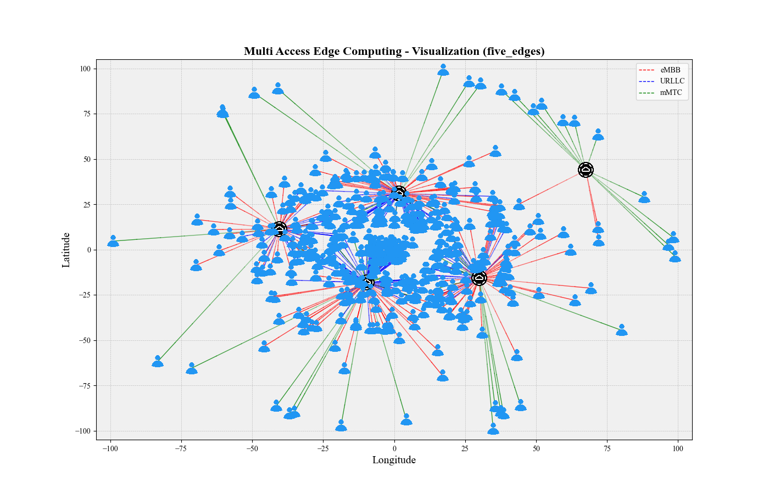
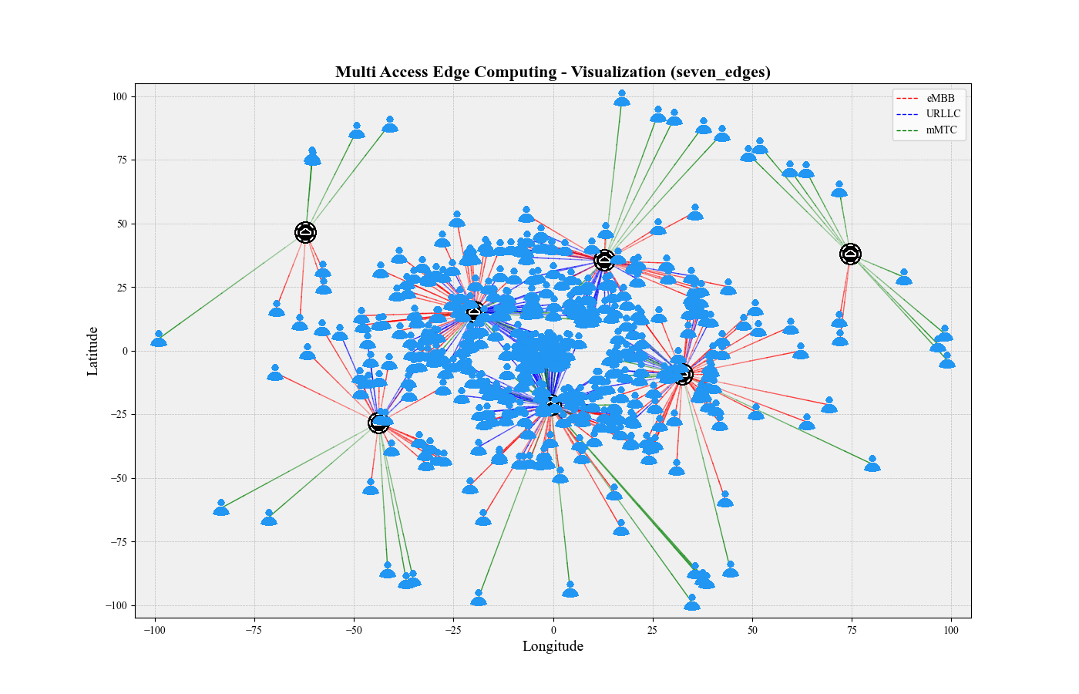
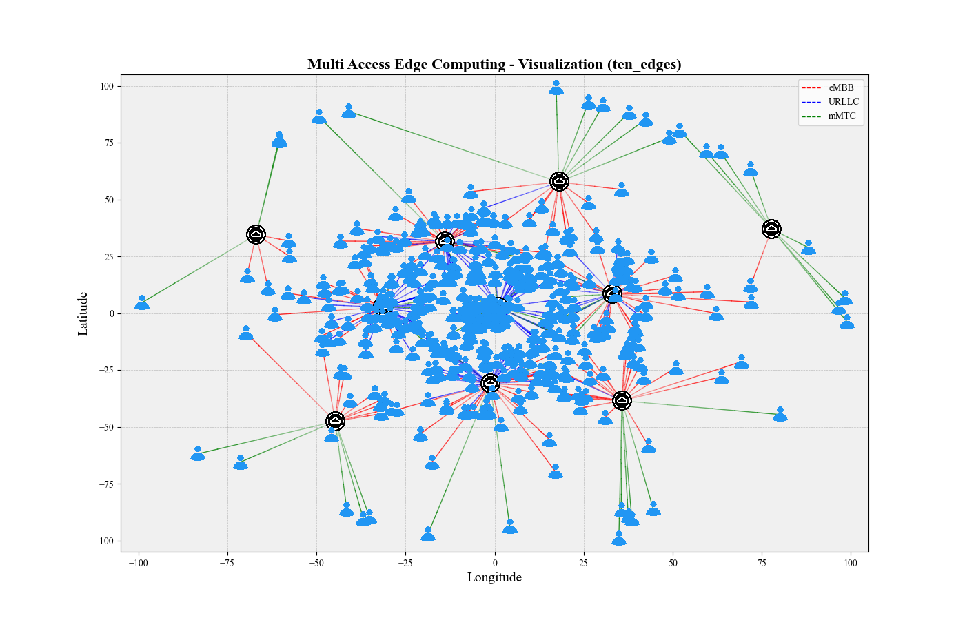
(II) MEC setup :
3 Edges:
5 Edges:
7 Edges:
10 Edges:

Slide 39
(III) Blockchain Logging :
Step 1: Ensure all these are installed and working :
Node.js & npm (for managing Solidity tools)
Ganache (for running a local Ethereum blockchain)
Truffle (for compiling and deploying smart contracts)
Web3.py (Python library for interacting with Ethereum)
Step 2: In Ganache start a blockchain workspace with 10 accounts and set it to listen on a port.

Slide 40
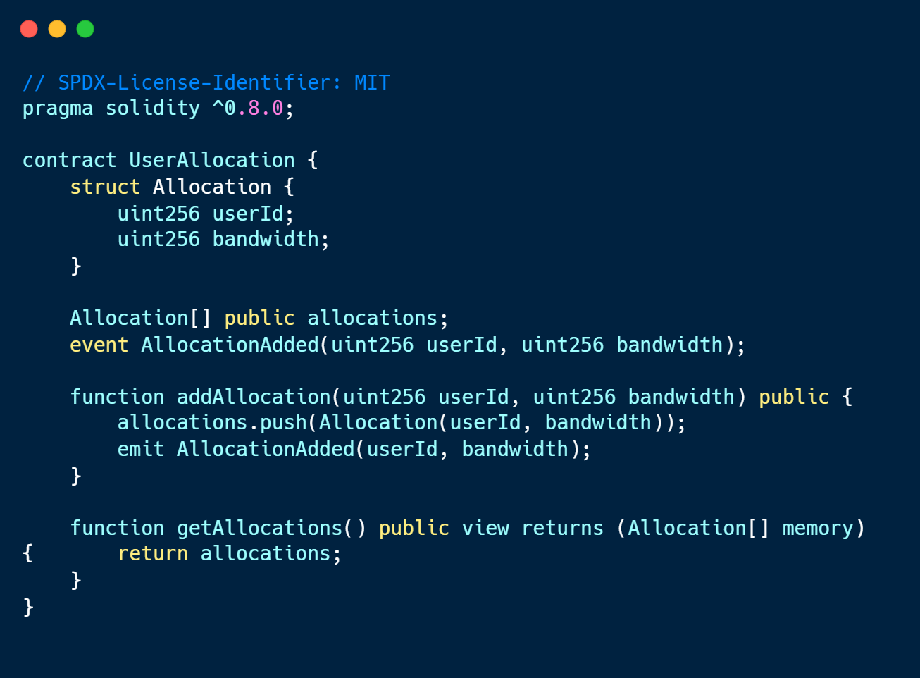
(III) Blockchain Logging :
Step 3: Create a new Solidity file in contracts/
UserAllocation.sol
Step 4 : Compile and deploy the truffe contracts .

Slide 41
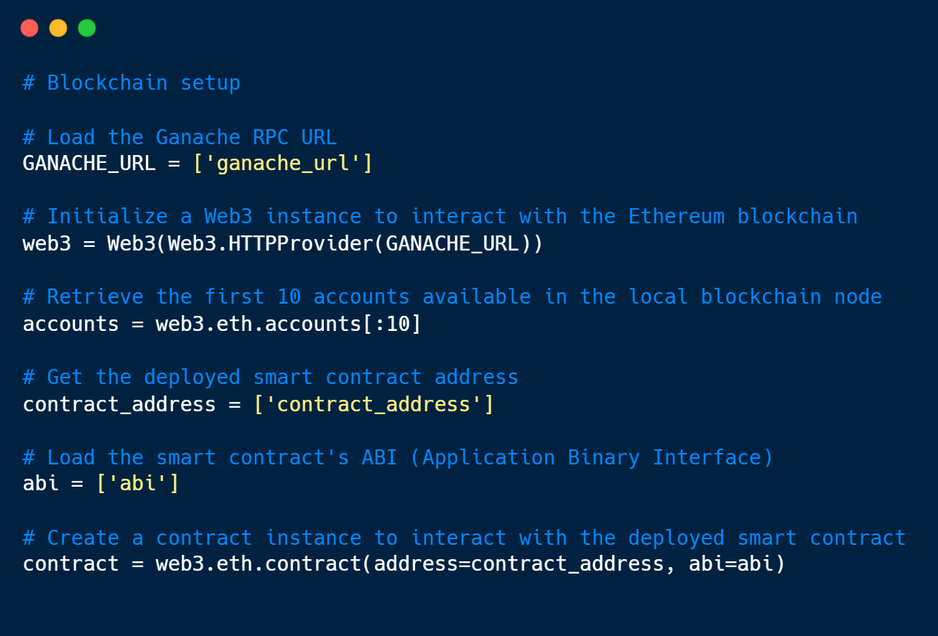
(III) Blockchain Logging :
Step 5: Configure the ganache url , contract address and Abi in python code using web3 to connect to blockchain via python.

Slide 42
(III) Blockchain Logging :
Step 6: Fetch blockchain data using Web3 API calls to query blocks, transactions, and details from a Ganache node like :
Step 7: Fetch data similarly for 3,5,7,10 edges and compare the results visually.
tx_hash: Unique identifier of the transaction
from: Sender's address
to: Receiver's address
gas_used: Gas consumed by the transaction
gas_price: Cost per unit of gas in Wei
transaction_fee: Total fee paid (gas_used * gas_price)
block_number: Block in which the transaction was included
timestamp: Time when the transaction was confirmed

Slide 43
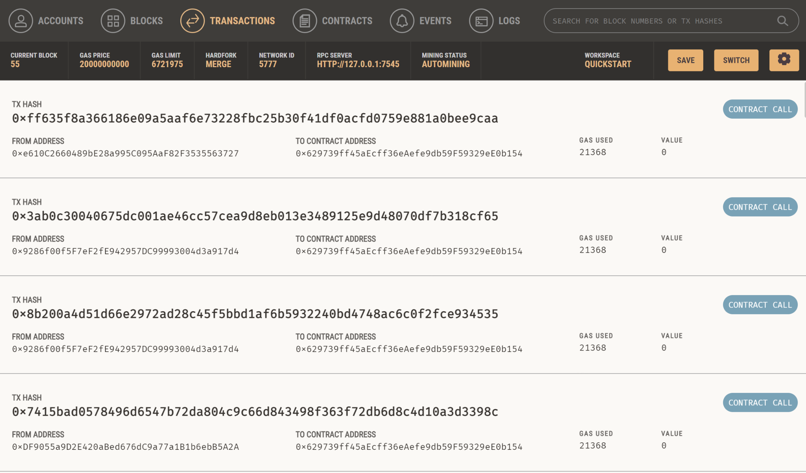
(III) Blockchain Logging :
Blockchain
Transactions
in Ganache →
Address of the respective edge node

Slide 44
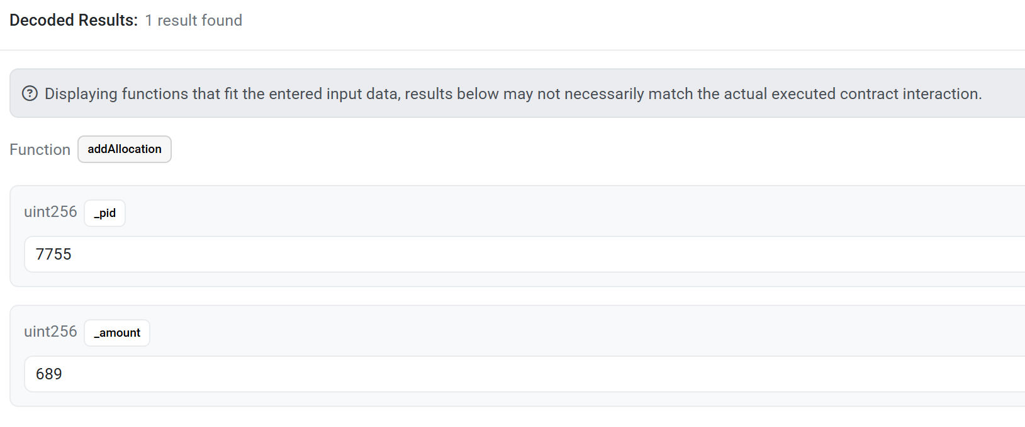
(III) Blockchain Logging :
Stored log data in blockchain :
User_ID
Allocated_Bandwidth

Slide 45
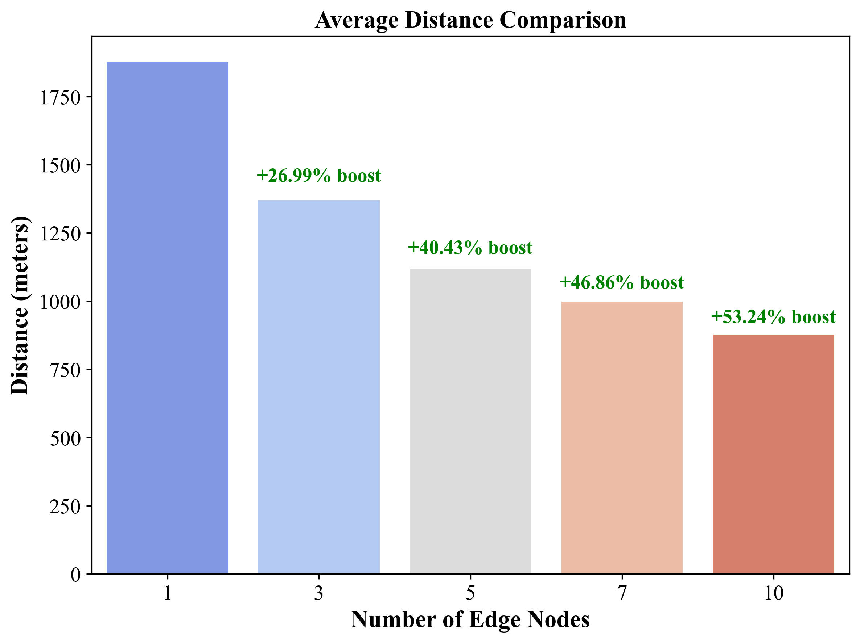
Result Analysis :
Average Distance Comparison:
- Increasing the edges reduces the distance.

Slide 46
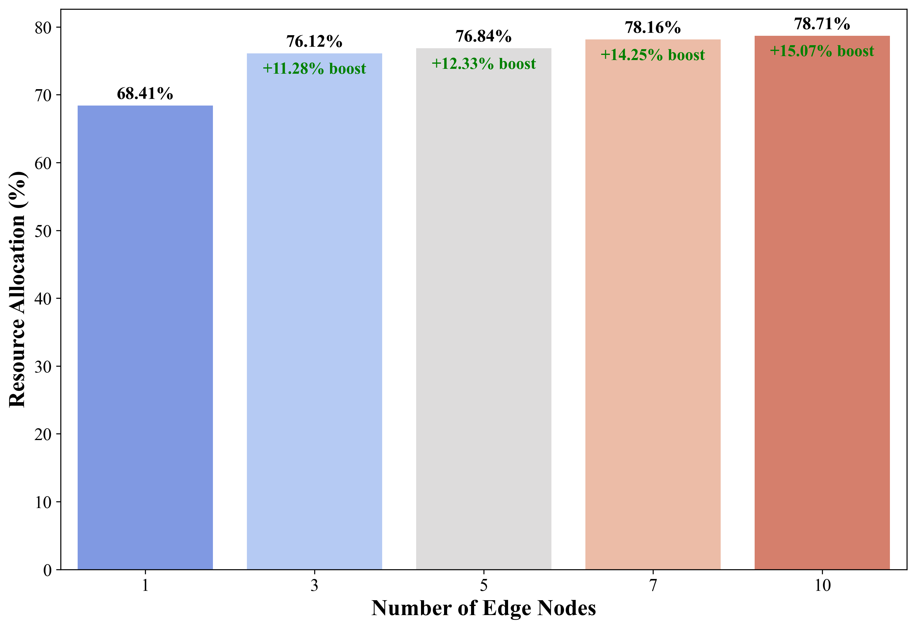
Result Analysis :
Average Resource Allocation Comparison:
- Increasing the edges provides better resource allocation.

Slide 47
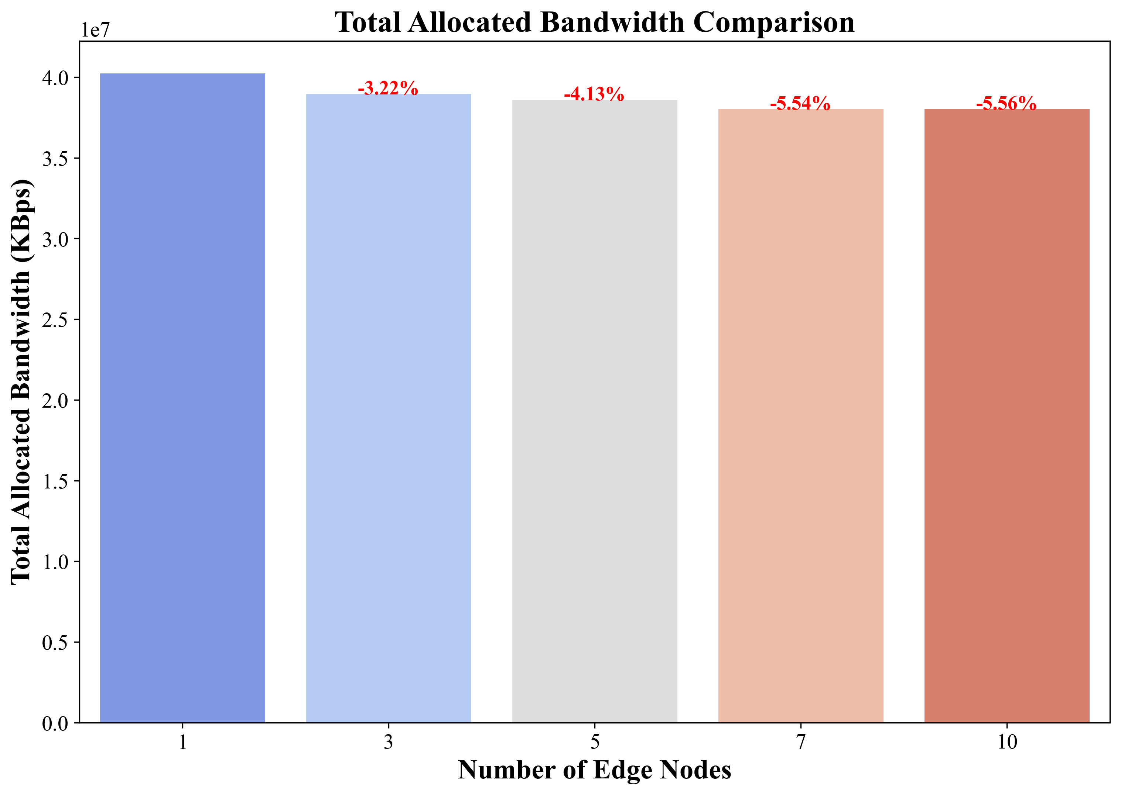
Result Analysis :
Total Allocated Bandwidth Comparison:
- Better resource allocation and QoS enforcements with lesser bandwidth.

Slide 48
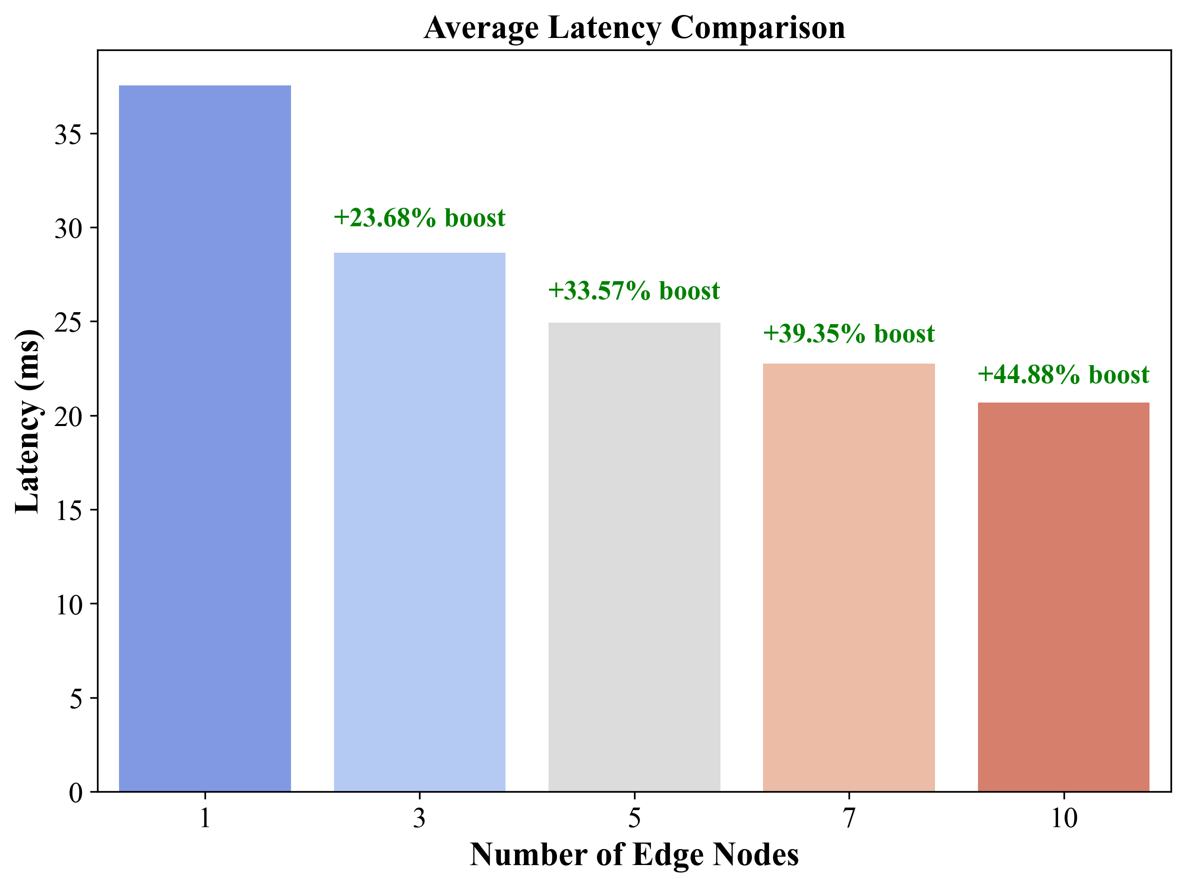
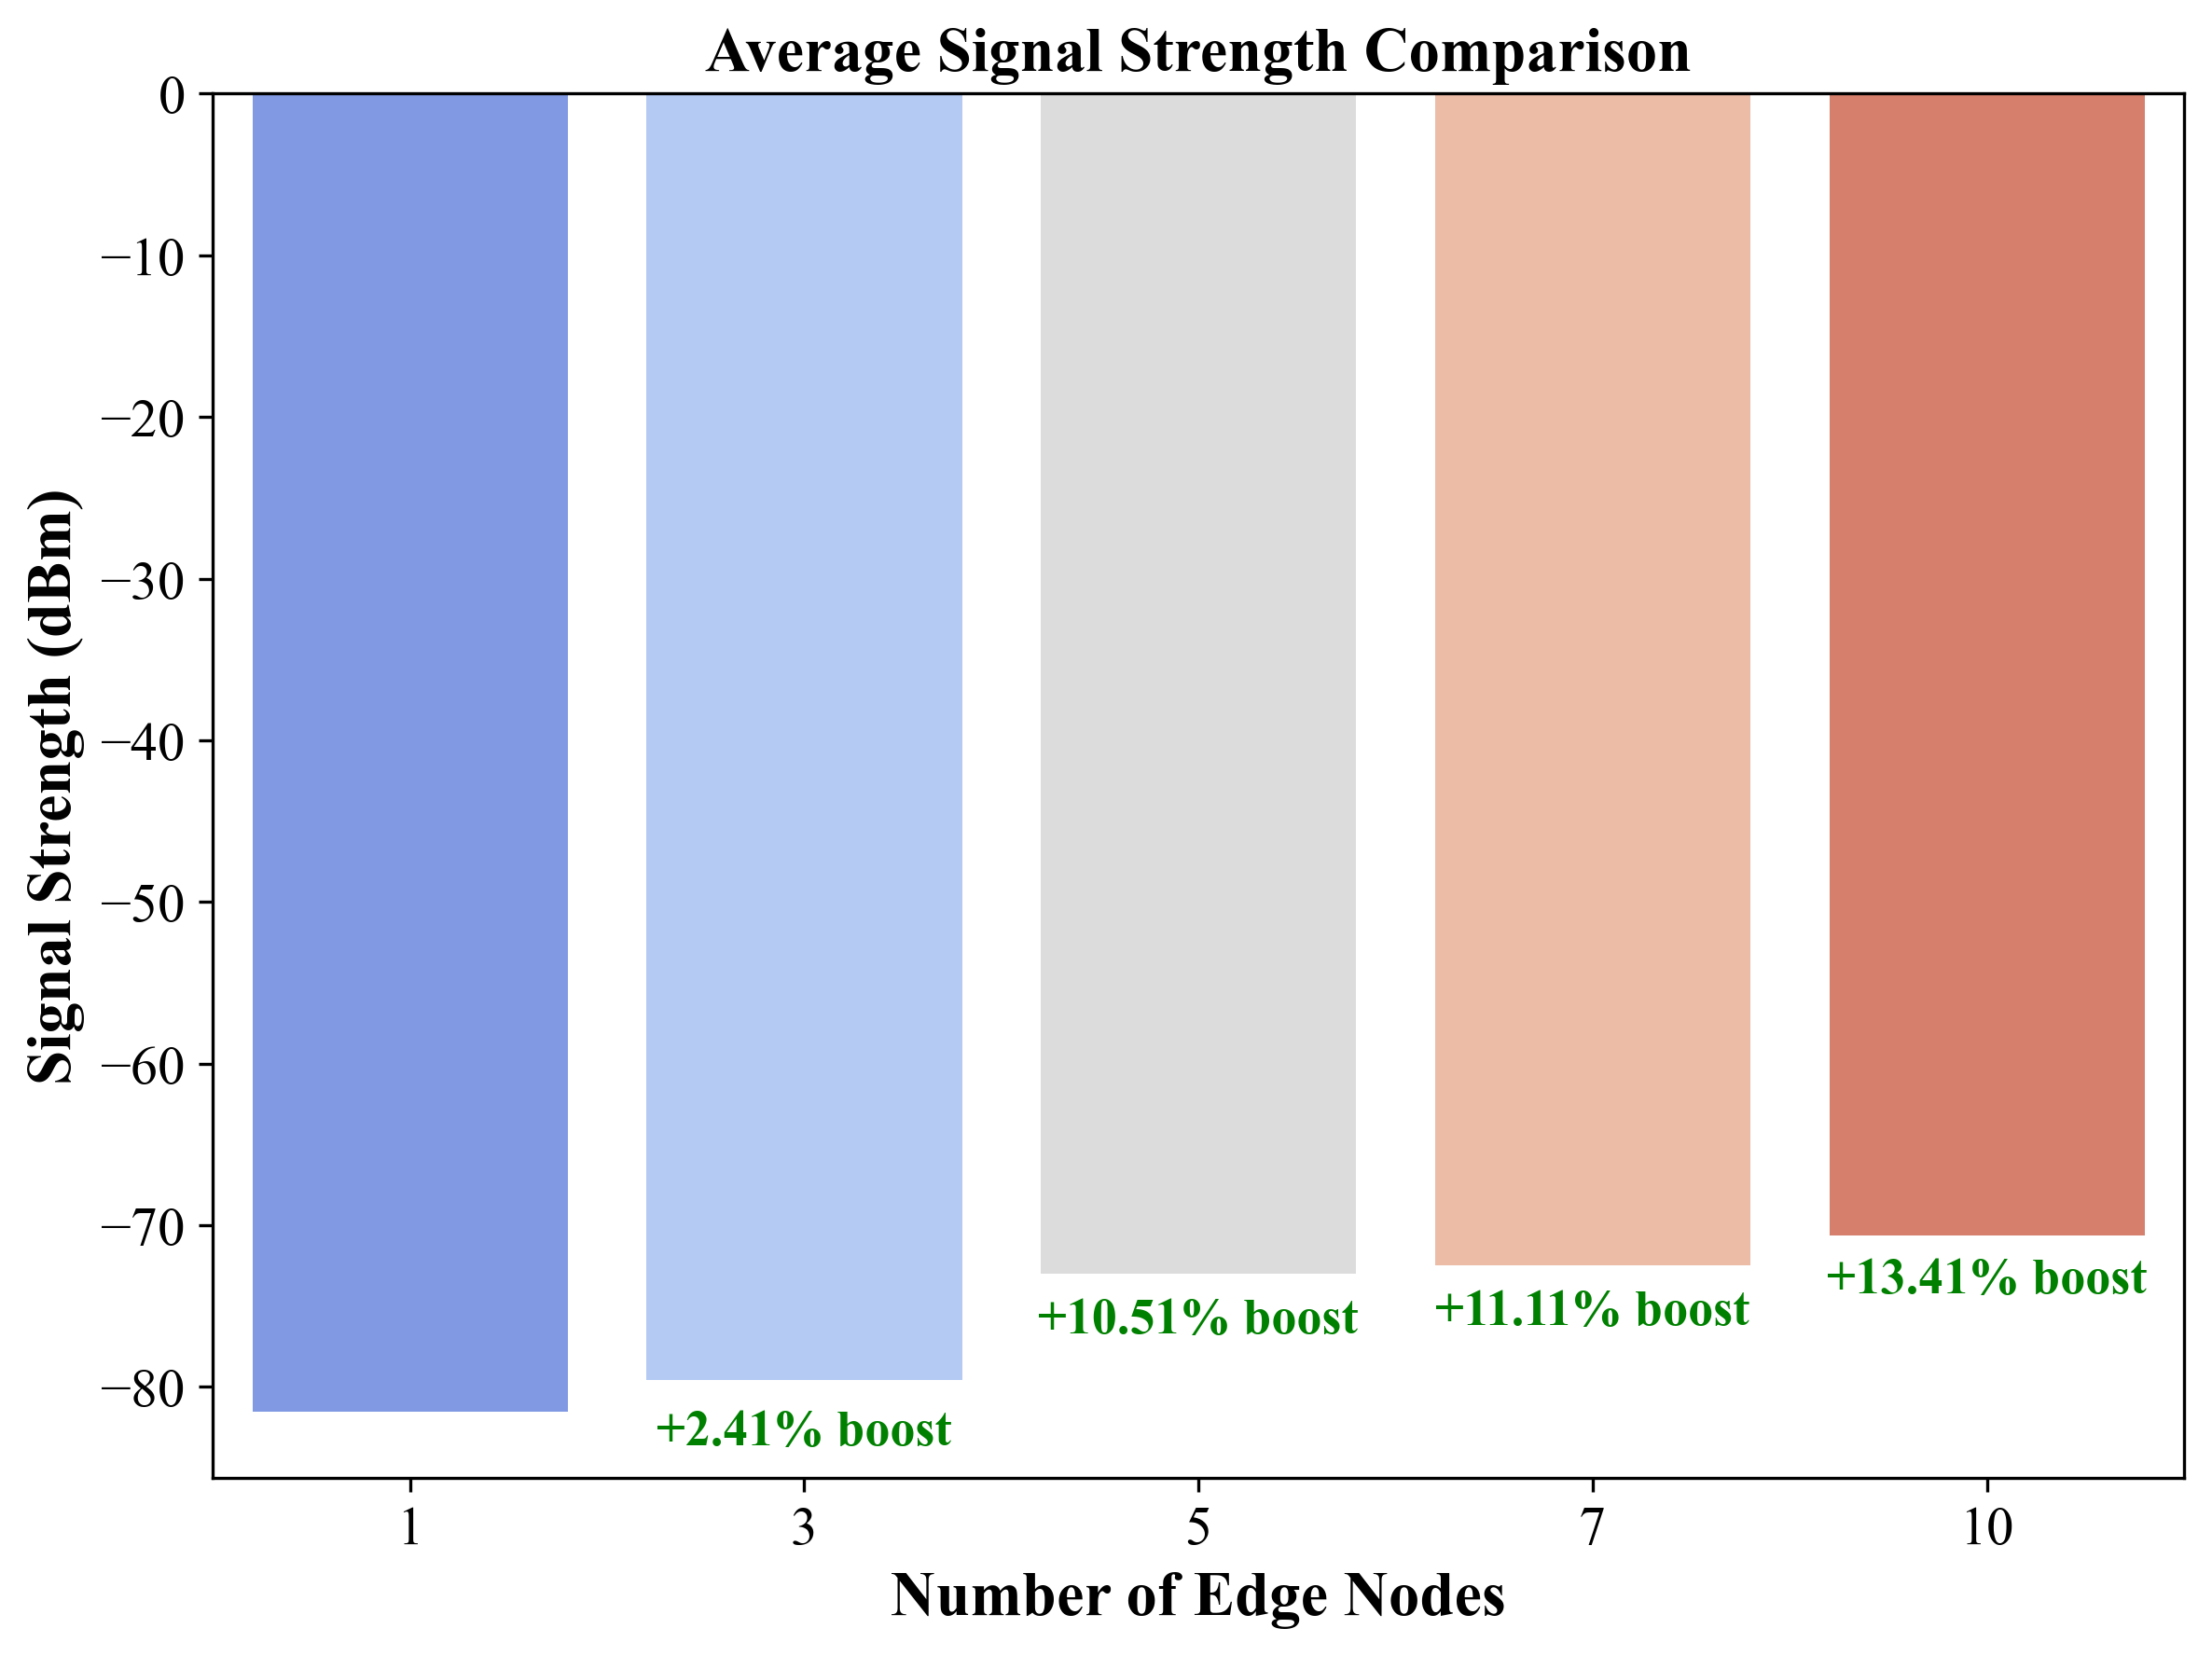
Result Analysis :
- Reduced distance improves Latency and Signal Strength

Slide 49
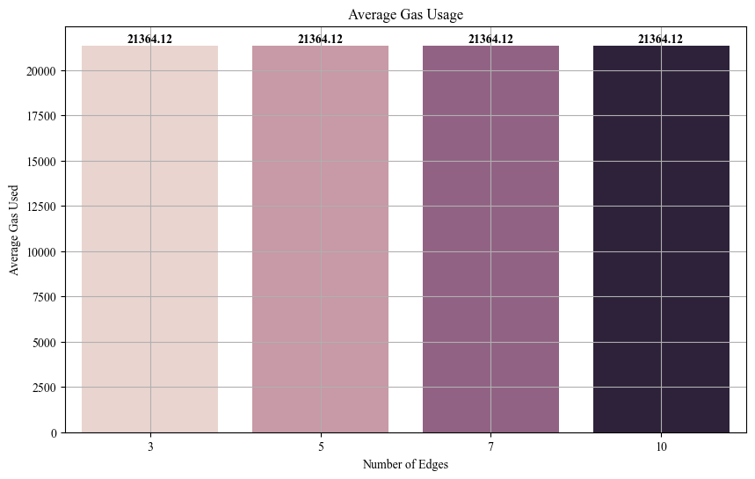
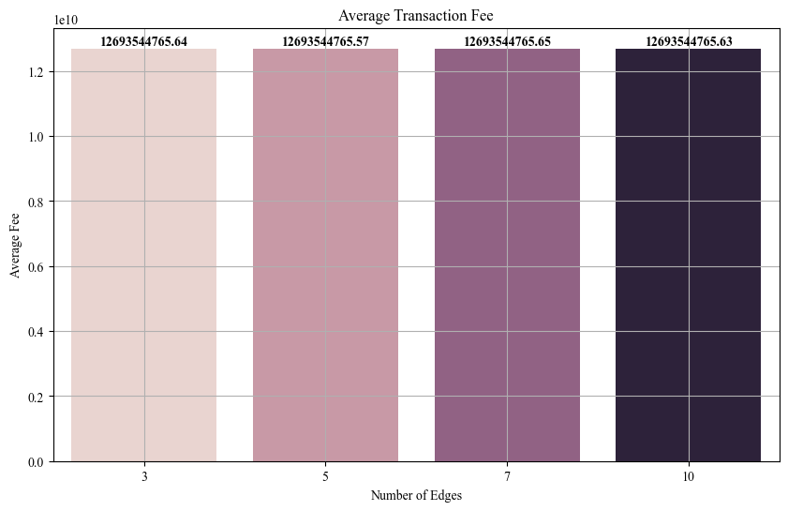
Result Analysis :
- Average Gas usage and transaction fee are same for all edge scenarios because each have same 15000 blockchain transactions

Slide 50
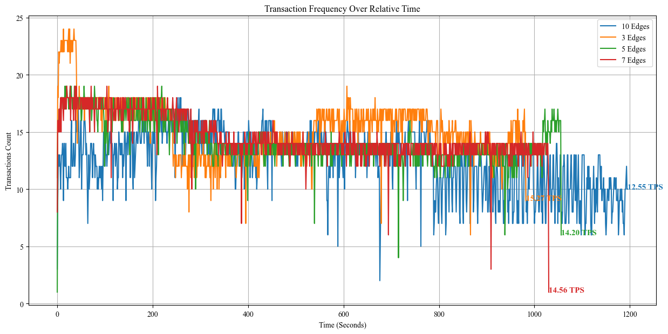
Result Analysis :
- Lesser edges provide faster transaction rates (Low latency due to lesser accounts)

Slide 51
Conclusion :
LightGBM optimized with Bayesian optimization using a Gaussian process outperforms other models in both resource allocation and allocated bandwidth prediction. Its faster execution time makes it ideal for deployment in edge nodes.
Migrating users across multiple edge nodes enhances signal strength and reduces latency, leading to improved resource allocation efficiency with lower bandwidth consumption. Additionally, network slicing ensures that users who do not meet the QoS requirements for a given slice receive additional bandwidth to maintain performance.
Furthermore, leveraging blockchain instead of traditional databases enhances the security and integrity of user allocation data, ensuring transparency, immutability, and protection against unauthorized modifications.

Slide 52
Individual Contributions:
Prithiv vijai UG – Performed network slicing and streamlined the execution.
Pukalvanan L – Evaluated several models for deploying in docker.
Karthik R – Retrieved blockchain transaction results.
Vinu V – Performed parameter optimization for the top models.

Slide 53
Pending works:
Comparative analysis of blockchain transaction results.
Documentation works.

Slide 54
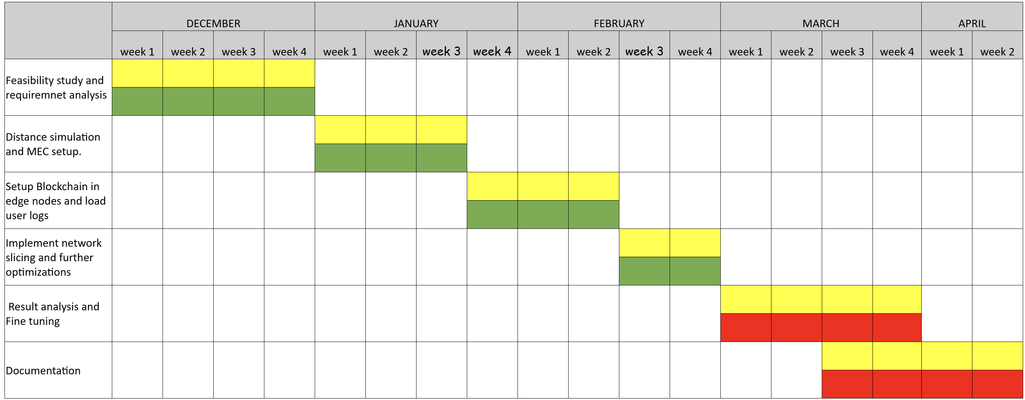
Timeline chart: -
Work in progress
Assigned Tasks
Works to be done

Slide 55
References: -
D. Ayepah-Mensah, G. Sun, G. O. Boateng, S. Anokye and G. Liu, "Blockchain-Enabled Federated Learning-Based Resource Allocation and Trading for Network Slicing in 5G," in IEEE/ACM Transactions on Networking, vol. 32, no. 1, pp. 654-669, Feb. 2024, doi: 10.1109/TNET.2023.3297390.
M. A. Togou et al., "DBNS: A Distributed Blockchain-Enabled Network Slicing Framework for 5G Networks," in IEEE Communications Magazine, vol. 58, no. 11, pp. 90-96, November 2020, doi: 10.1109/MCOM.001.2000112.
I.H. Abdulqadder and S. Zhou, "SliceBlock: Context-Aware Authentication Handover and Secure Network Slicing Using DAG-Blockchain in Edge-Assisted SDN/NFV-6G Environment," in IEEE Internet of Things Journal, vol. 9, no. 18, pp. 18079-18097, 15 Sept.15, 2022, doi: 10.1109/JIOT.2022.3161838.
G. O. Boateng, G. Sun, D. A. Mensah, D. M. Doe, R. Ou and G. Liu, "Consortium Blockchain-Based Spectrum Trading for Network Slicing in 5G RAN: A Multi-Agent Deep Reinforcement Learning Approach," in IEEE Transactions on Mobile Computing, vol. 22, no. 10, pp. 5801-5815, 1 Oct. 2023, doi: 10.1109/TMC.2022.3190449.
C. Campolo, A. Iera, A. Molinaro and G. Ruggeri, "MEC Support for 5G-V2X Use Cases through Docker Containers," 2019 IEEE Wireless Communications and Networking Conference (WCNC), Marrakesh, Morocco, 2019, pp. 1-6, doi: 10.1109/WCNC.2019.8885515.

Slide 56
References: -
T. Kwantwi, G. Sun, N. A. E. Kuadey, G. T. Maale and G. Liu, "Blockchain-Based Computing Resource Trading in Autonomous Multi-Access Edge Network Slicing: A Dueling Double Deep Q-Learning Approach," in IEEE Transactions on Network and Service Management, vol. 20, no. 3, pp. 2912-2928, Sept. 2023, doi: 10.1109/TNSM.2023.3240301.
Y. Gong, S. Sun, Y. Wei and M. Song, "Deep Reinforcement Learning for Edge Computing Resource Allocation in Blockchain Network Slicing Broker Framework," 2021 IEEE 93rd Vehicular Technology Conference (VTC2021-Spring), Helsinki, Finland, 2021, pp. 1-6, doi: 10.1109/VTC2021-Spring51267.2021.9449081.
X. Hou, Z. Ren, K. Yang, C. Chen, H. Zhang and Y. Xiao, "IIoT-MEC: A Novel Mobile Edge Computing Framework for 5G-enabled IIoT," 2019 IEEE Wireless Communications and Networking Conference (WCNC), Marrakesh, Morocco, 2019, pp. 1-7, doi: 10.1109/WCNC.2019.8885703.

Slide 57
THANK YOU!

